Slide 1
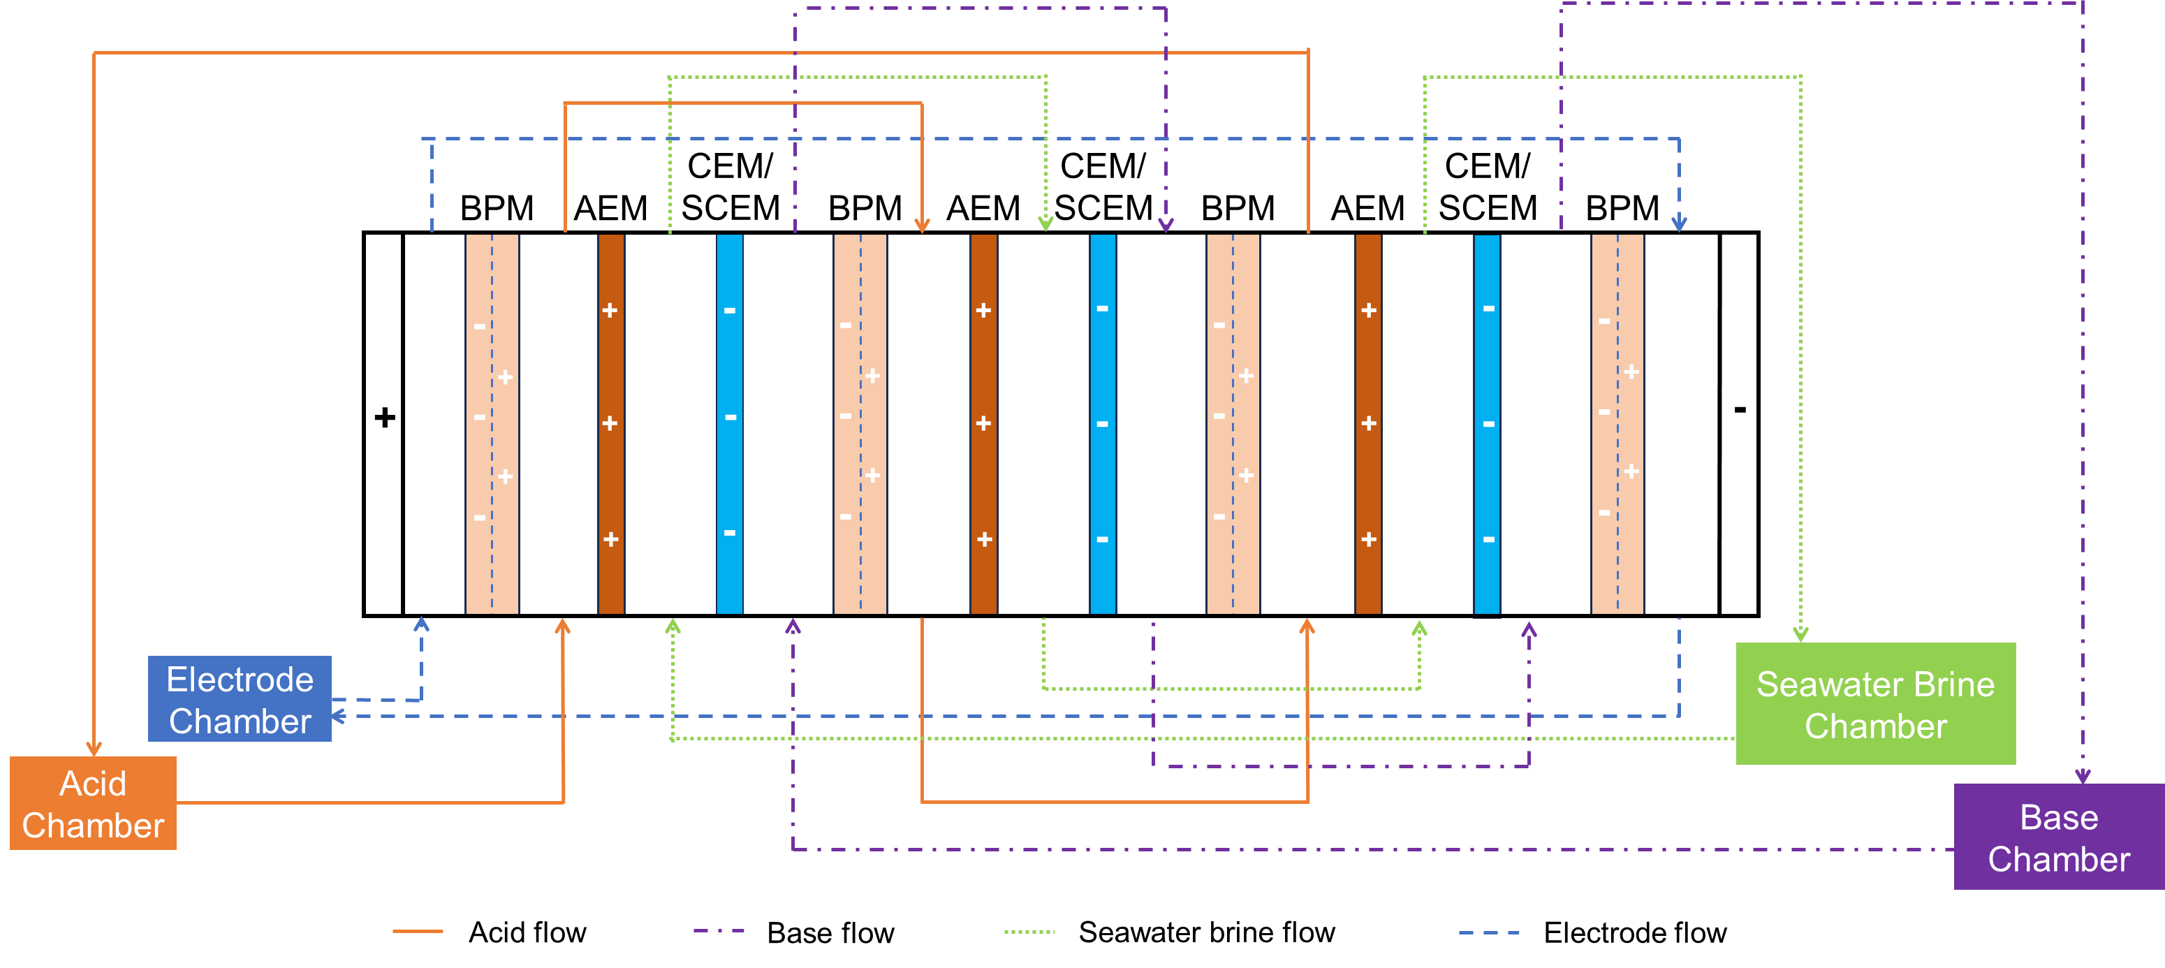
Outline
Introduction
Material and Methods
2.1 Lab-scale BMED Stack
The figure of setup
2.2 Protocol
2.3 Scaling Characterization and BMED Performance Analysis
2.3.1 Scaling characterization
SEM, EDS, XRD, turbidimeter
Calculation of scaling(R_{Mg}, R_{Ca}, mass of scaling)
2.3.2 BMED Performance Analysis
Conductivity, voltage, pH
Energy consumption
SI

Slide 2
3. Results and Discussion
3.1 Scaling in BMED
3.1.1 Scaling characterization in BMED system
When treating NaCl, there is no scaling →SEM and EDS
When treating SWB, there is severe scaling in the chamber and membrane
Chamber → Turbidity before and after experiments
Membrane → photo of membranes after experiments
Explore the scaling formation mechanism
Where scaling is formed → SEM and EDS of each membrane surface/cross-section
CEM facing SWBC
CEM facing BC
BPM facing BC
What is the composition → XRD, SEM&EDS of crystal
Why scaling is formed
CEM facing SWBC: Water splitting (major) → pH decrease in salt chamber; OH⁻ leakage (minor)→ transport number decrease (membrane deformation, crystal block…)
CEM facing BC: divalent ion transport
BPM facing BC: High concentration of OH⁻
Conclusion

Slide 3
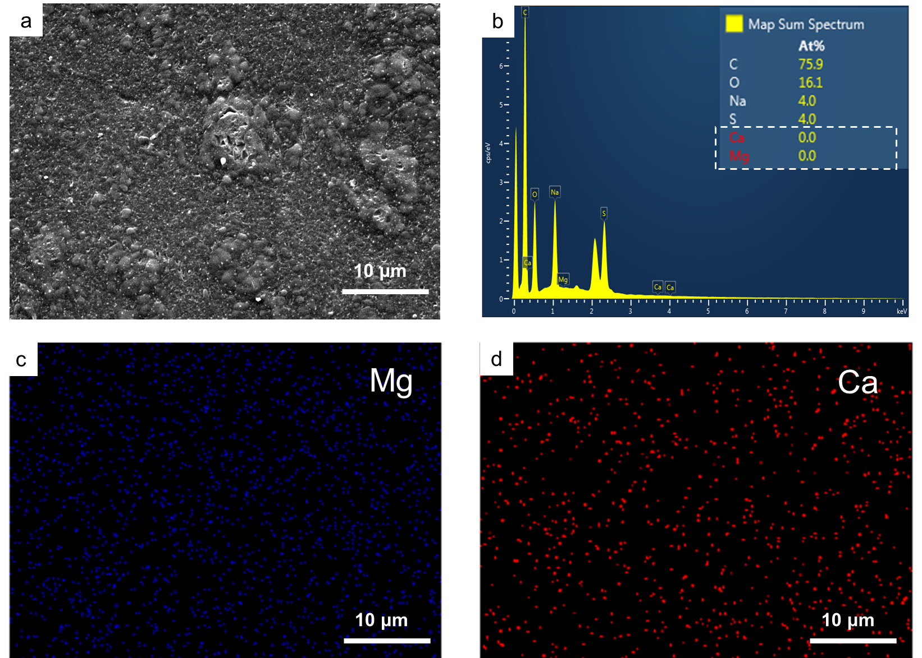
3. Results and Discussion
3.1 Scaling in BMED
3.1.1 Scaling characterization in BMED system
When treating NaCl, there is no scaling →SEM and EDS
SI

Slide 4
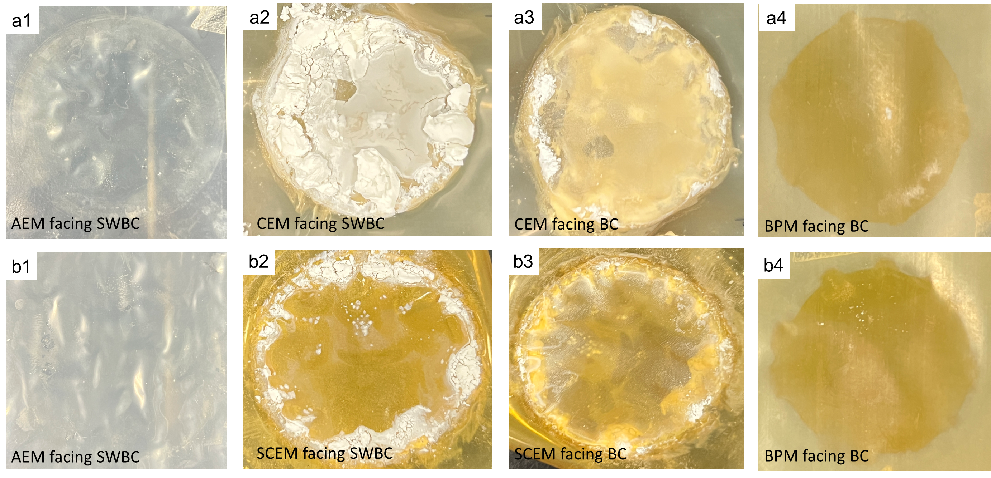
3. Results and Discussion
3.1 Scaling in BMED
3.1.1 Scaling characterization in BMED system
When treating NaCl, there is no scaling →SEM and EDS
When treating SWB, there is severe scaling in the chamber and membrane
Chamber → Turbidity before and after experiments
Membrane → photo of membranes after experiments
SI
SI

Slide 5
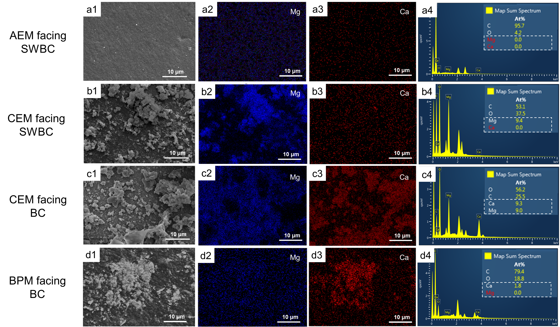
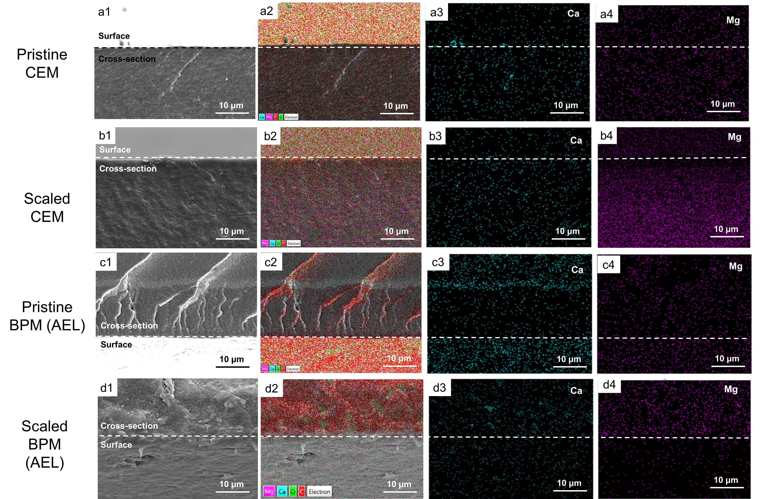
3. Results and Discussion
3.1 Scaling in BMED
3.1.1 Scaling characterization in BMED system
When treating NaCl, there is no scaling →SEM and EDS
When treating SWB, there is severe scaling in the chamber and membrane
Chamber → Turbidity before and after experiments
Membrane → photo of membranes after experiments
Explore the scaling formation mechanism
Where scaling is formed → SEM and EDS of each membrane surface/cross-section
CEM facing SWB, CCEM facing BC, BPM facing BC

Slide 6
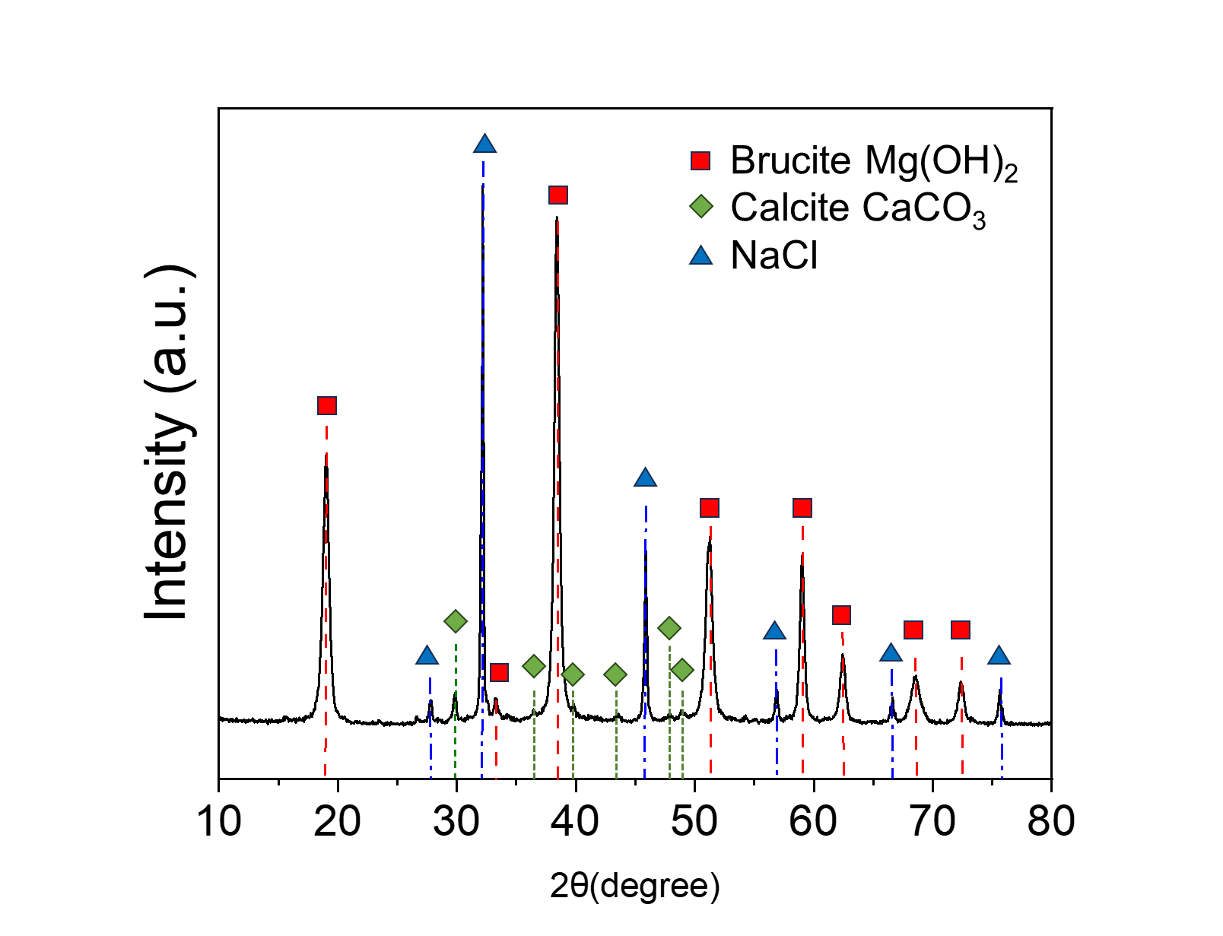
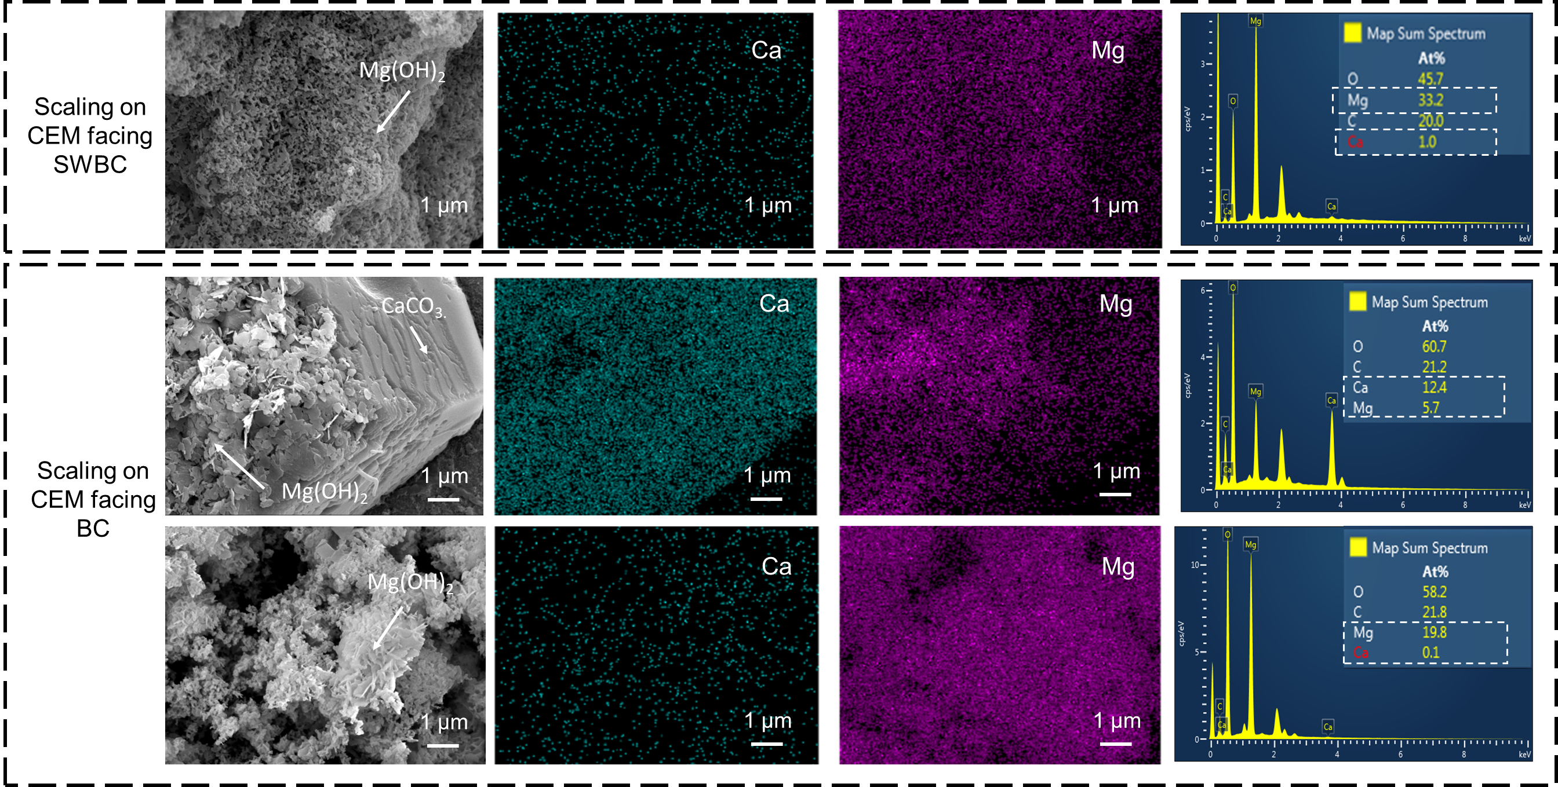
3. Results and Discussion
3.1 Scaling in BMED
3.1.1 Scaling characterization in BMED system
When treating NaCl, there is no scaling →SEM and EDS
When treating SWB, there is severe scaling in the chamber and membrane
Chamber → Turbidity before and after experiments
Membrane → photo of membranes after experiments
Explore the scaling formation mechanism
Where scaling is formed → SEM and EDS of each membrane surface/cross-section
CEM facing SWBC, CEM facing BC, BPM facing BC
What is the composition → XRD, SEM&EDS of crystal

Slide 7
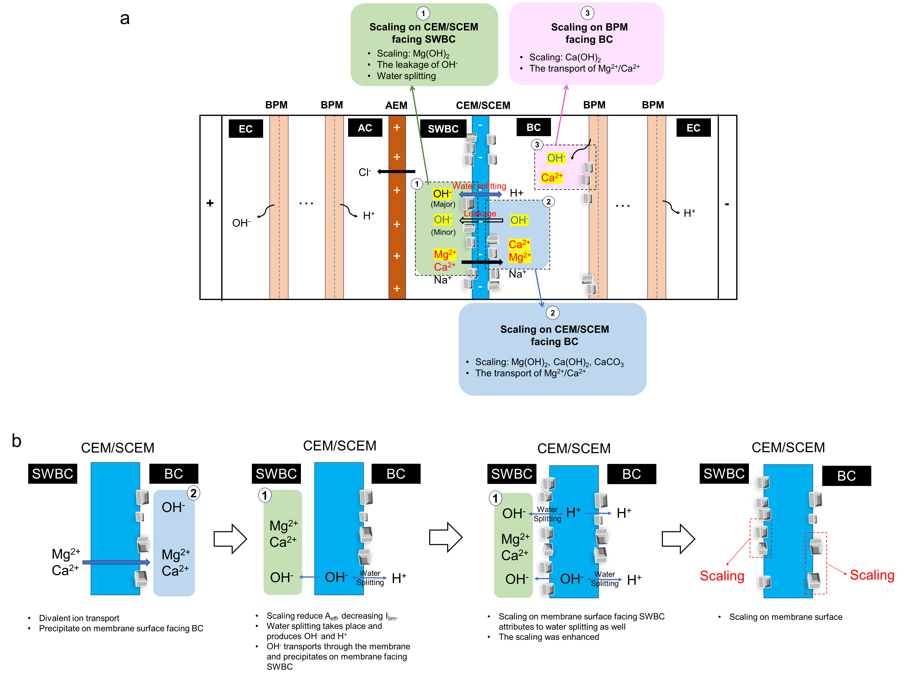
3. Results and Discussion
3.1 Scaling in BMED
3.1.1 Scaling characterization in BMED system
When treating NaCl, there is no scaling →SEM and EDS
When treating SWB, there is severe scaling in the chamber and membrane
Chamber → Turbidity before and after experiments
Membrane → photo of membranes after experiments
Explore the scaling formation mechanism
Where scaling is formed
CEM facing SWBC
CEM facing BC
BPM facing BC
What is the composition
Why scaling is formed
CEM facing SWBC:
Water splitting (major) → pH decrease in salt chamber;
OH⁻ leakage (minor)→ transport number decrease
(membrane deformation, crystal block…)
CEM facing BC: divalent ion transport
BPM facing BC: High concentration of OH⁻
Conclusion

Slide 8
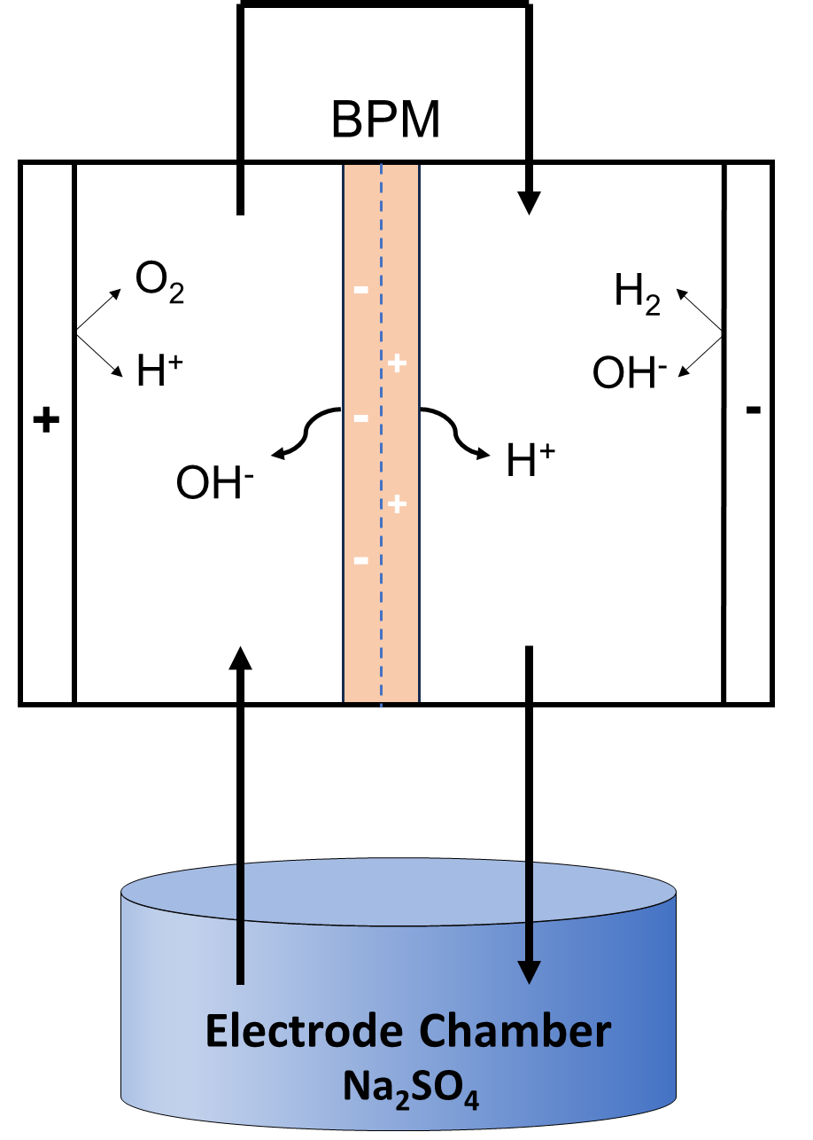
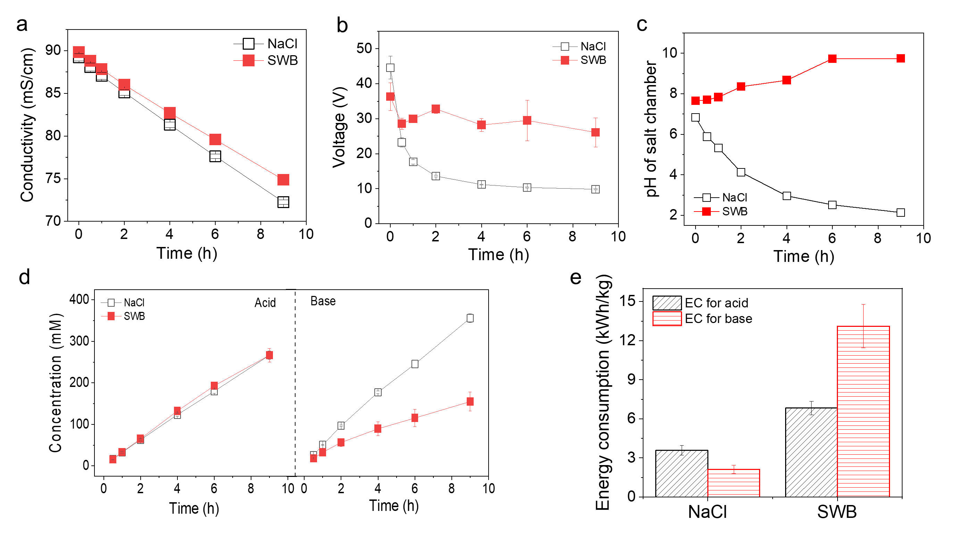
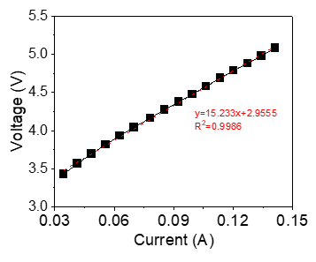
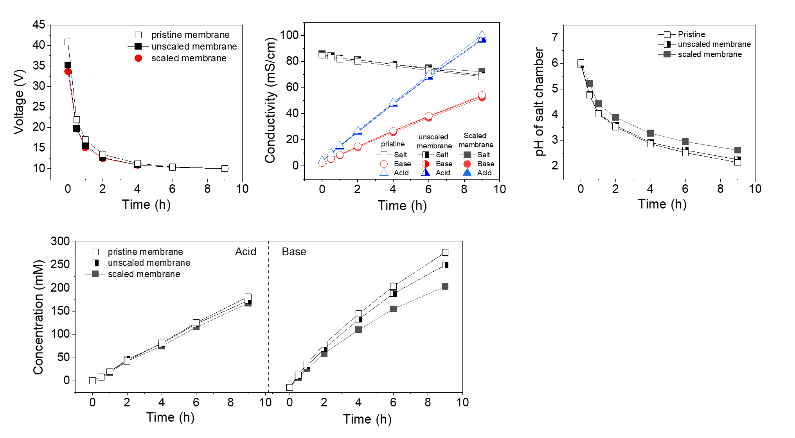
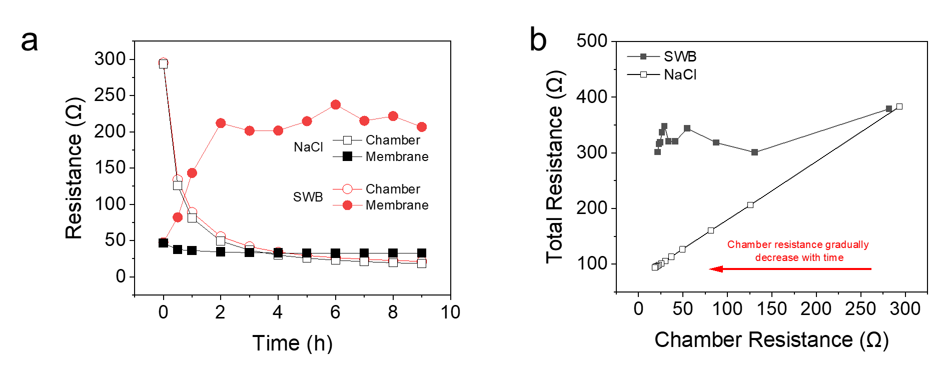
3.1.2 Effect of Scaling on BMED Performance
Conductivity, voltage, concentration of acid/base, pH of salt chamber, SEC
Voltage change → membrane resistance
Reversibility testing → The necessity to mitigate scaling on membrane
SI

Slide 9
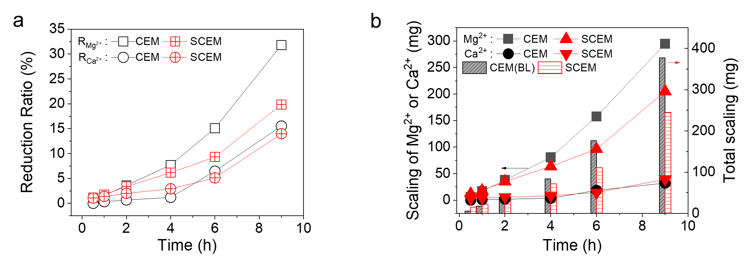
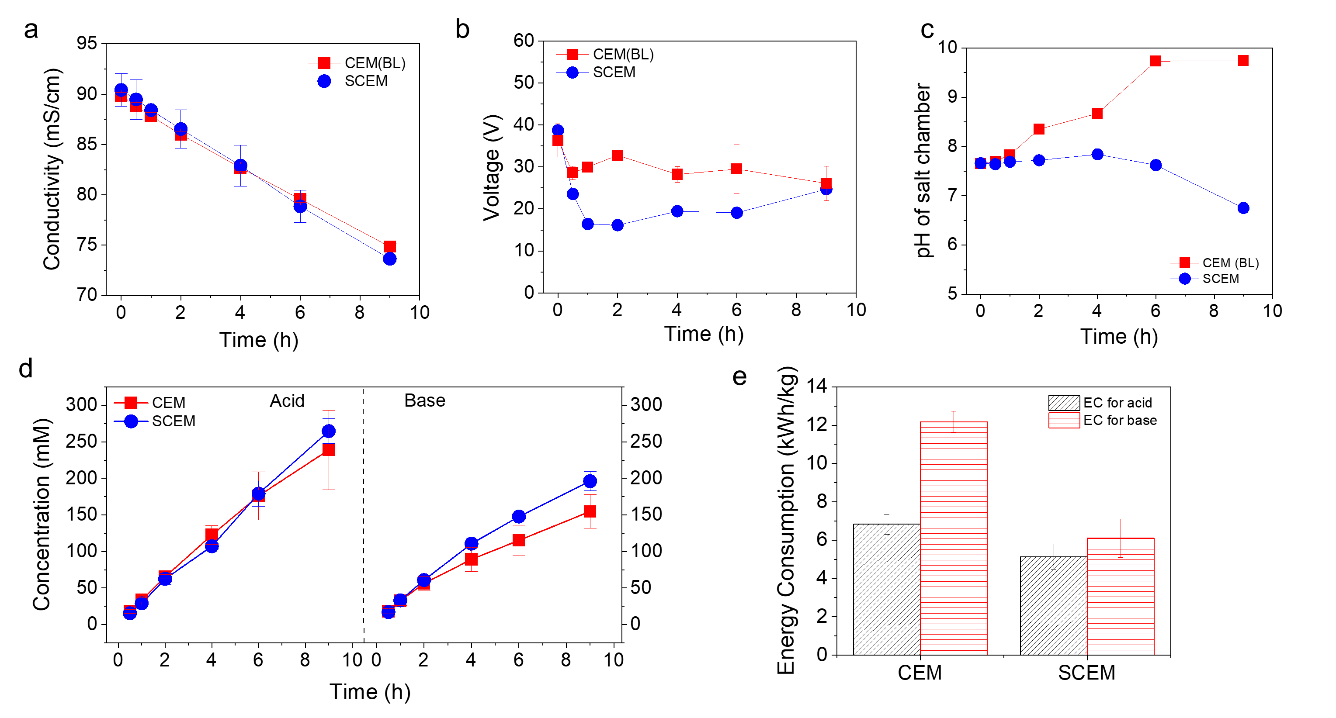
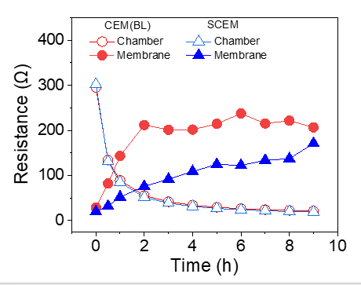
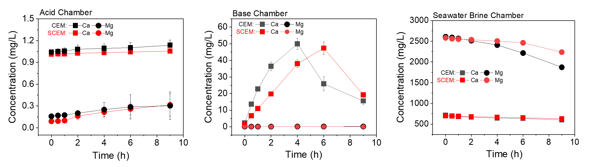
3.2 Effect of Mono-/di-valent selectivity of CEM on scaling
Quantification of scaling
- Performance
SI

Slide 10
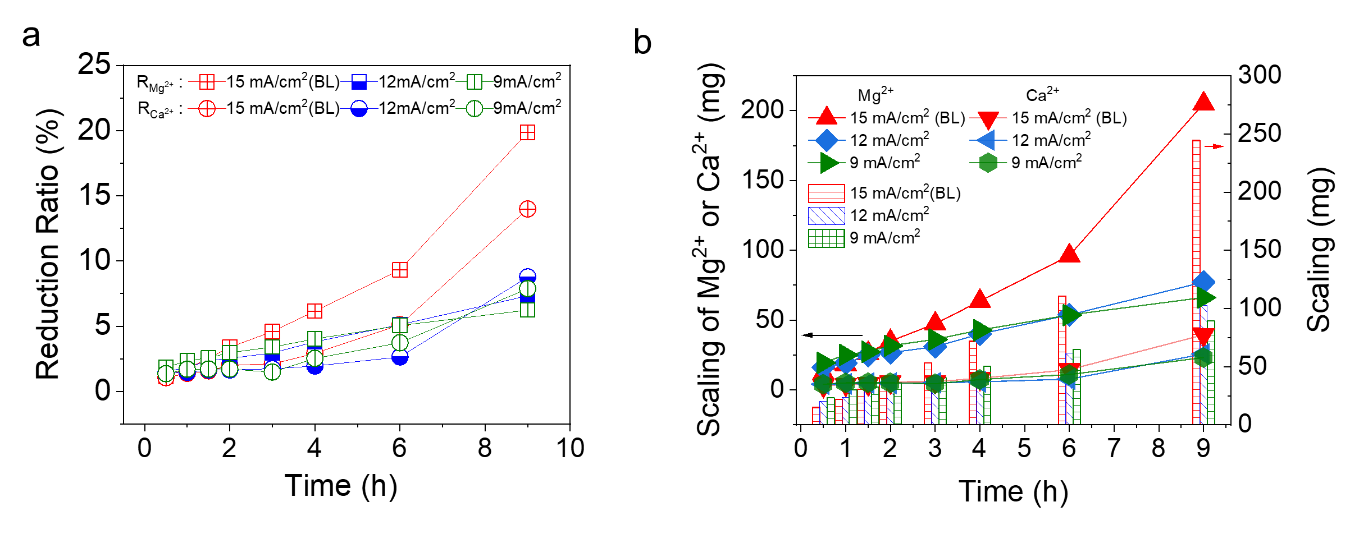
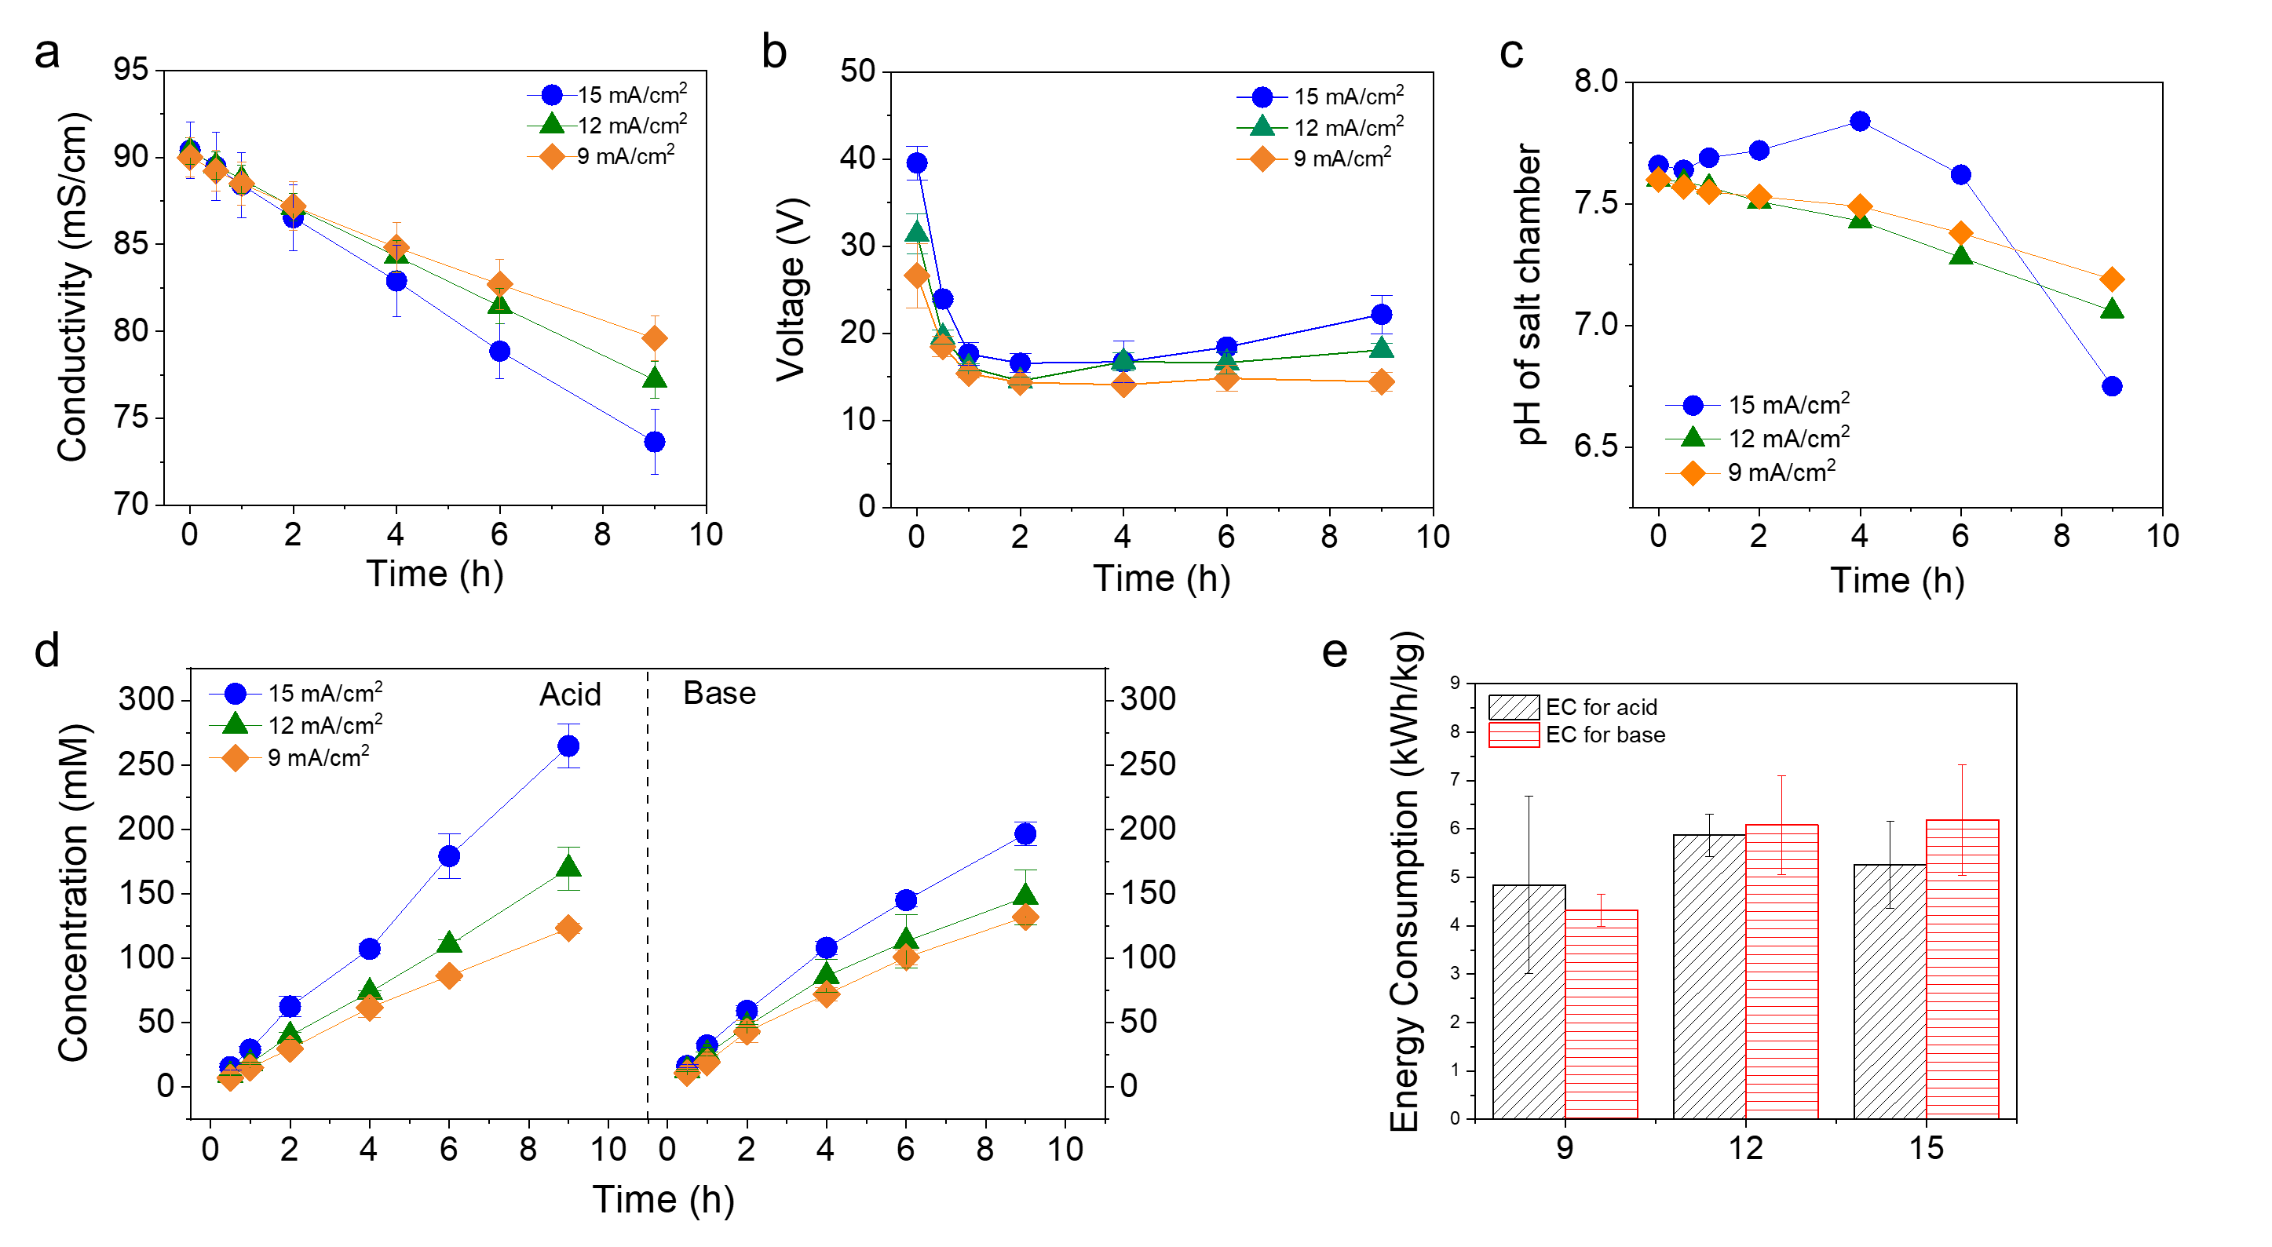
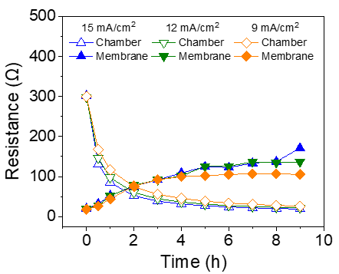
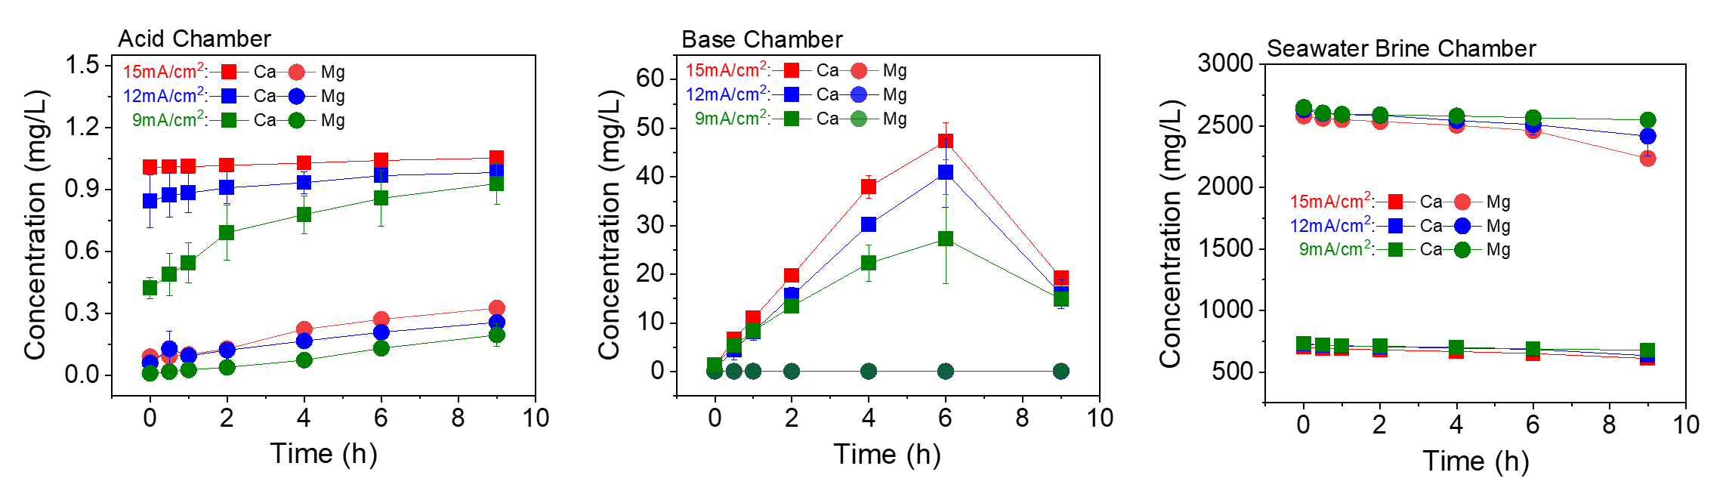
3.3 Effect of current density on scaling
Quantification of scaling
- Performance
SI

